Slide 1
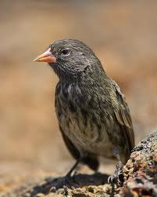
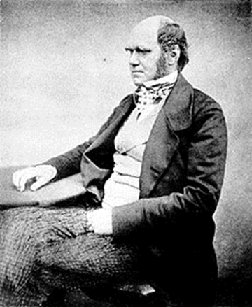
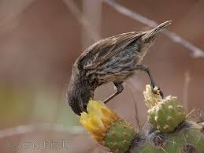
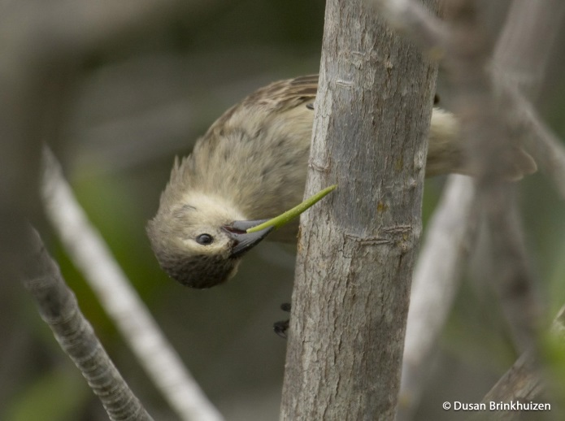
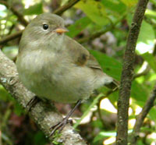
Darwin’s Finches
Jen and Steve Smyth

Slide 2
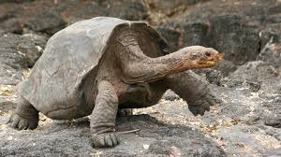
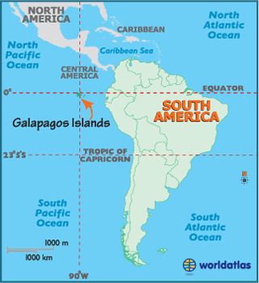
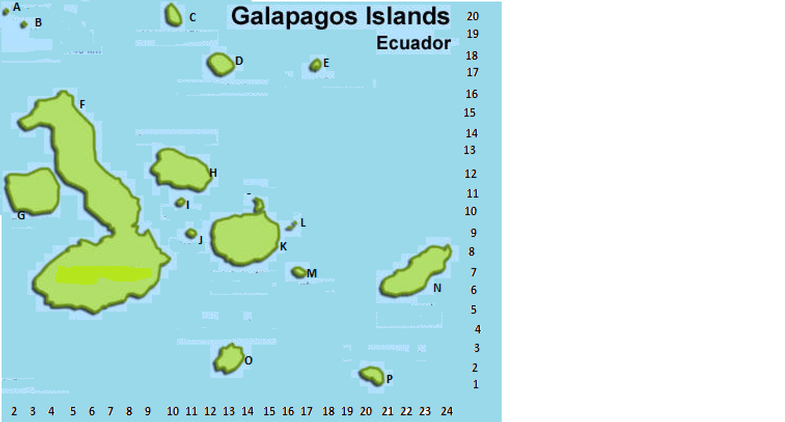
On a scatter of Pacific islands
Spread the finches sons and daughters
The isles are known as the Galapagos
Because of all the things they “taught us”.

Slide 3
Here’s a sharp-beaked ground finch
From the isle of Genovesa
Its beak is used for getting food
From flowers it sucks the nectar.

Slide 4
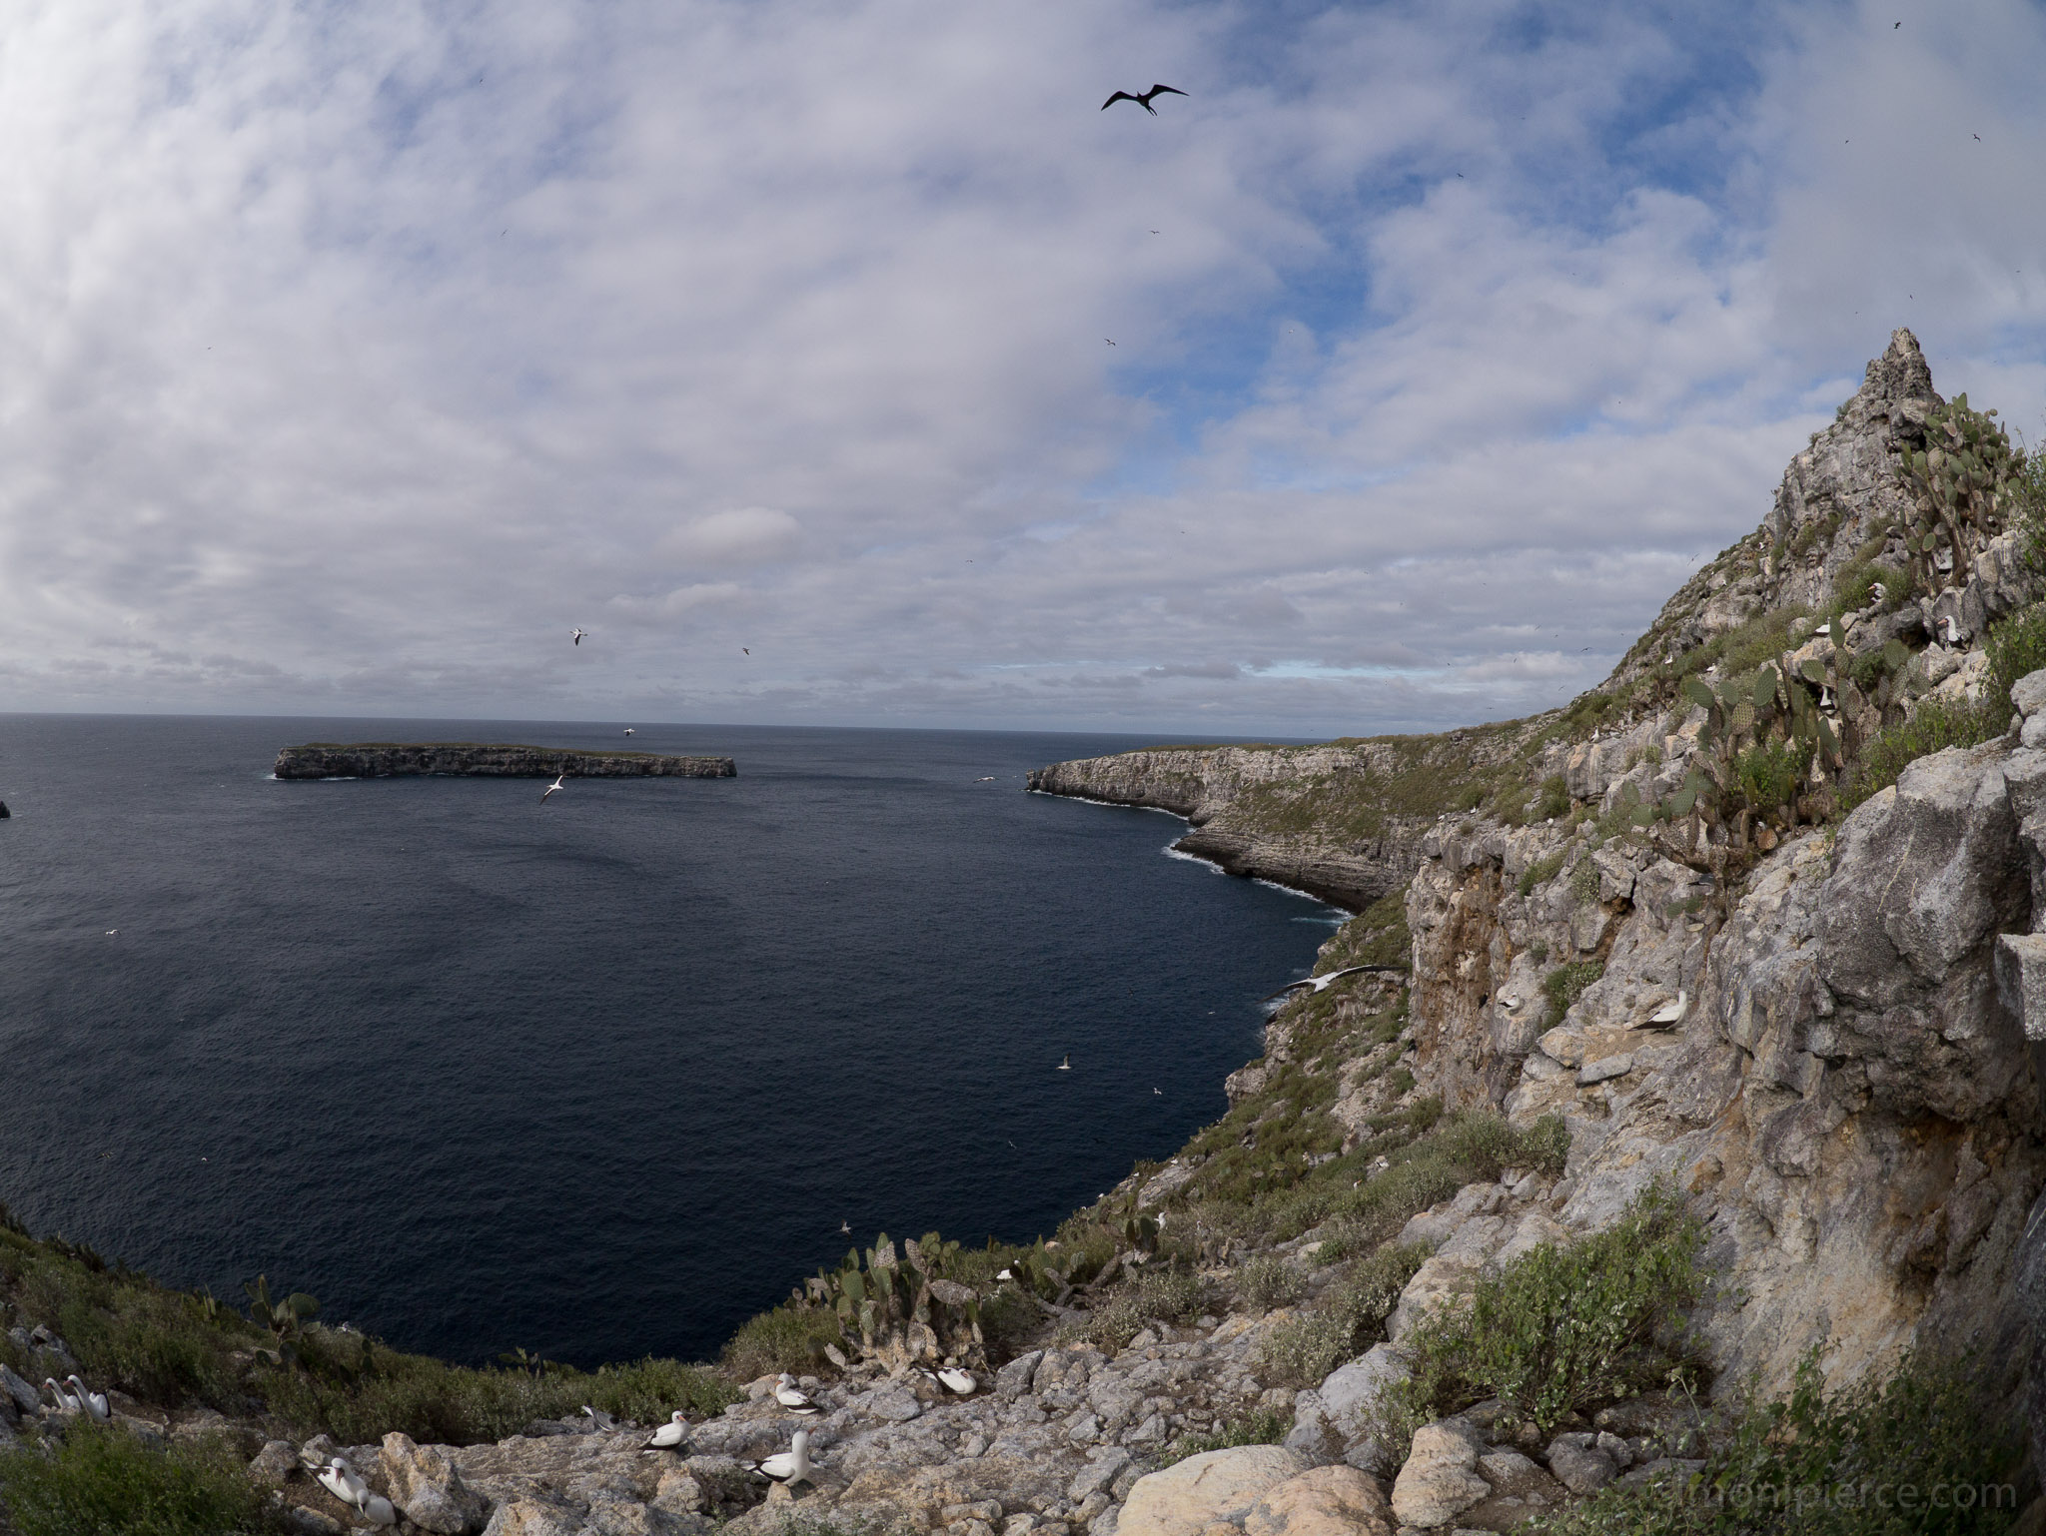
But on the island known as Wolf
A place that’s bare and dull

Slide 5
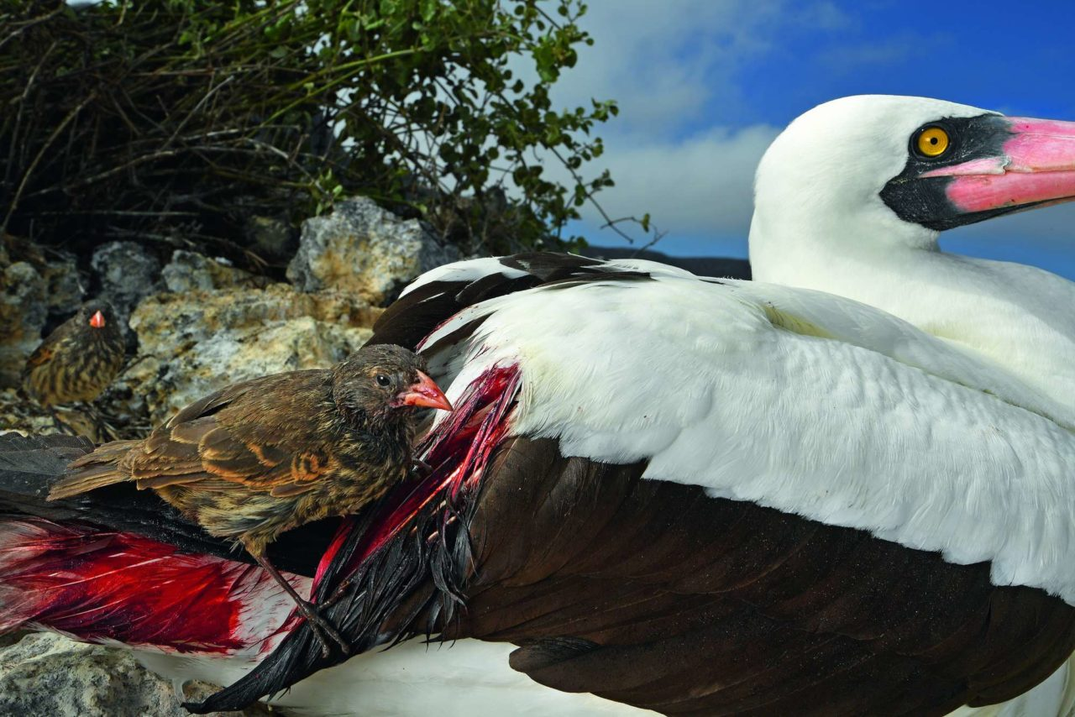
The same sharp beak is used to take
Blood from booby and from gull.

Slide 6
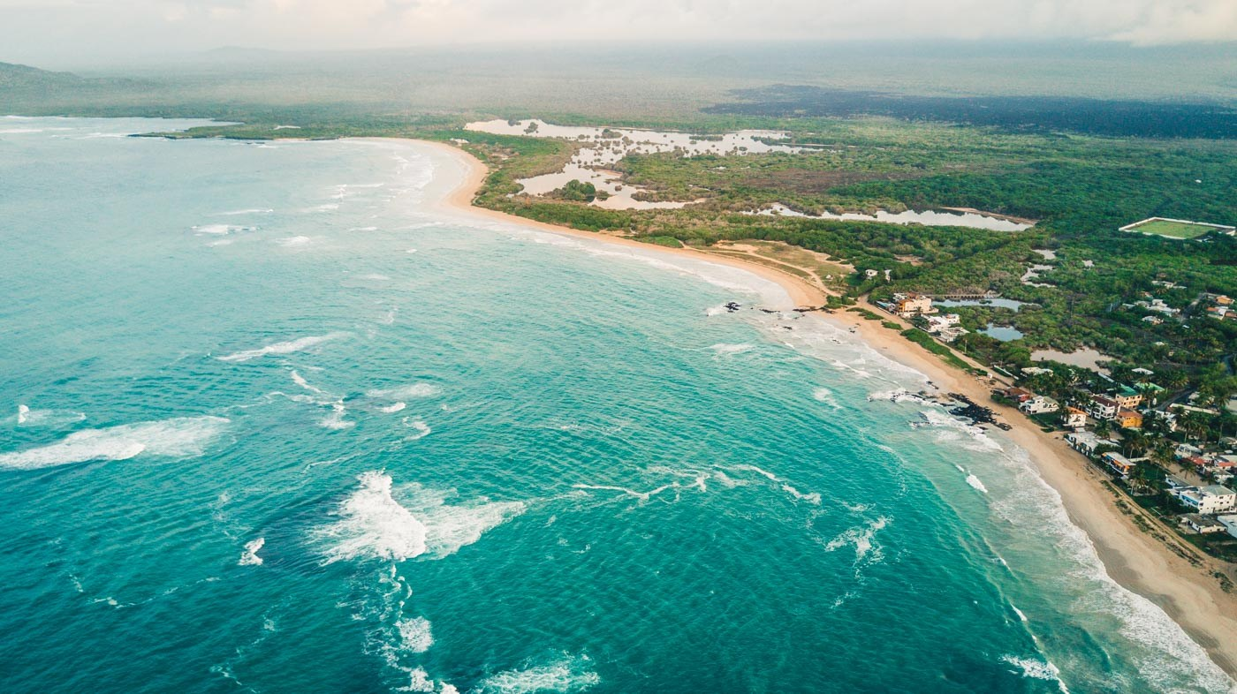
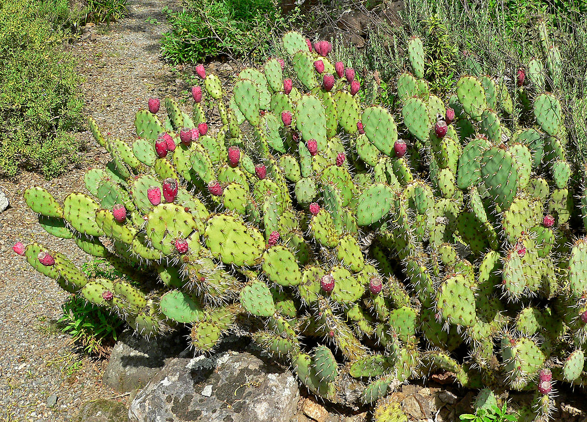
On the island Isabella
Grows the cactus called prickly pear
And also the cactus-eating ground finch
Which has grown up living there.

Slide 7
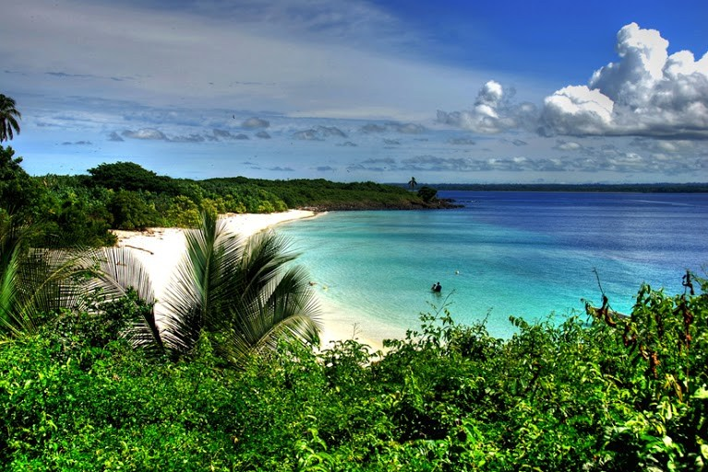
On the island Santiago
On the hillside’s cooling breeze
Lives the very clever Woodpecker Finch
Lifting insects from the bark of trees.

Slide 8
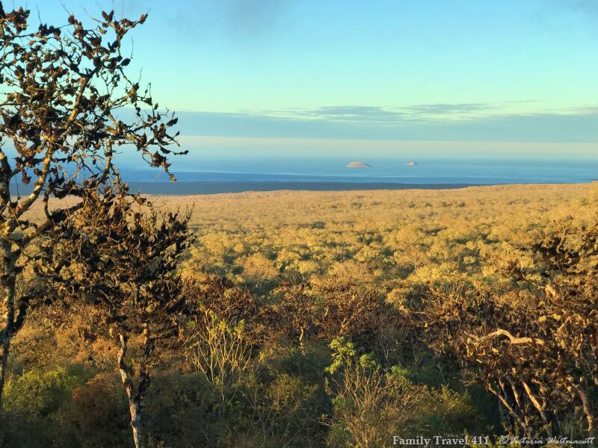
In the hot wet forest of Santa Cruz
Lives a bird that’s hard to see
The warbler finch is coloured green
Blending with the forest canopy.

Slide 9
All these different species come
From a single breeding pair
Blown on the wind a million years ago
To start a colony there

Slide 10
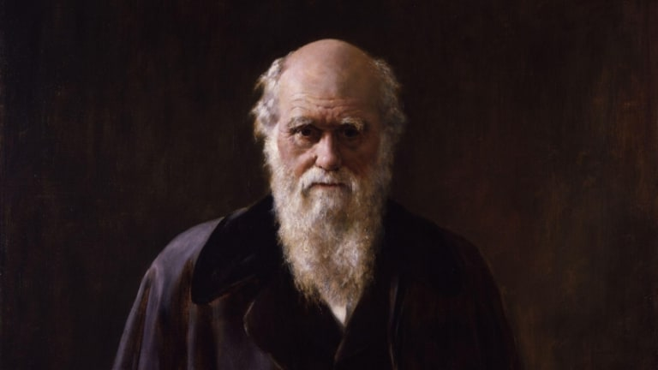
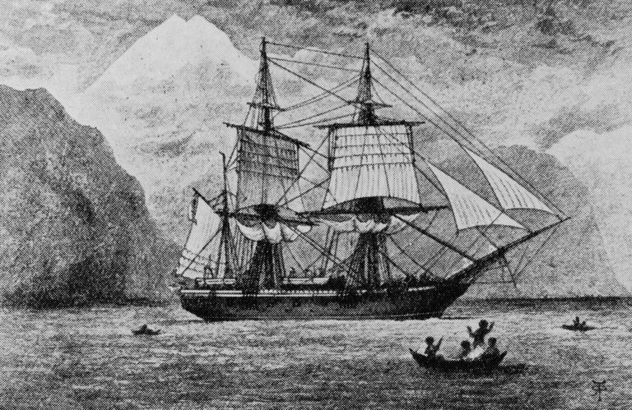
These cut-off isles with unique birds
Provided part of the solution
For Charles Darwin when he came to write
His theory of evolution

